Slide 1
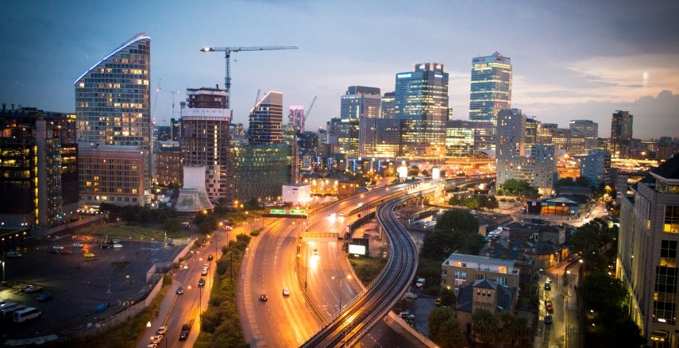
Selection of location for Multiplex Establishment in Pune - India
Submitted By – Swaroop Todankar
Date – 28th August 2019

Slide 2
TABLE OF CONTENTS
Introduction
Business Problem
Target Audience
Data Required
Methodology
Results
Observations
Conclusion
References

Slide 3
Introduction
Indian Film Industry ranks 1st in number of films produced and admissions [1].
Even though the multiplex are just 27 percent of the total screens, these contribute to about 45 percent of the total revenue of cinema [2].
Pune is the second largest city in the state of Maharashtra and ranks 9th in terms of population in India with a population of 3.13 Million [3].
The main advantage of Multiplex is that multiple movies can be screened in at a single location and people are presented with a choice of entertainment.

Slide 4
Business Problem
The main question is- If an organization is deciding to open a Multiplex establishment in Pune, which location would be the best considering all the factors?

Slide 5
Target Audience
The target audience in this scenario are normal people who want to spend their leisure time for watching movies.
The private organizations which are interested in running such a business venture.

Slide 6
Data Required
Neighbourhood Data
Location Data
Venue Data

Slide 7
Methodology
Importing Necessary Libraries
Web Scraping
Visualization
Obtaining Venues
One Hot Encoding
Clustering
Cluster Visualization

Slide 8
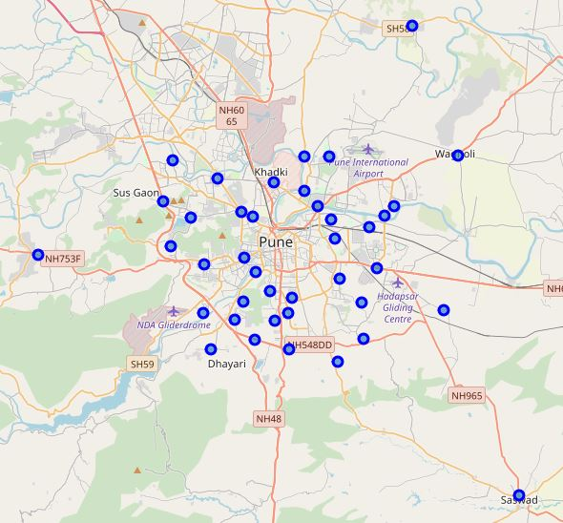
Results (Neighbourhoods of Pune)

Slide 9
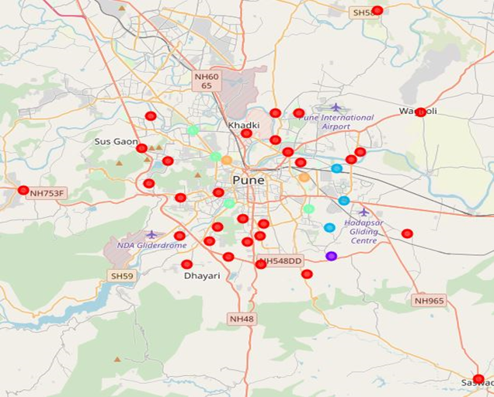
Results ( Clusters of Neighbourhoods)

Slide 10
Observations
Cluster label 0 represented by the red colour has the maximum number of elements as compared to other clusters
Cluster label 2 represented by sky blue colour has only one element
Cluster label 0 seems to be spread around the outskirts of Pune city
The number of multiplexes in Cluster label 0 is the least and in Cluster label 2 it is the maximum

Slide 11
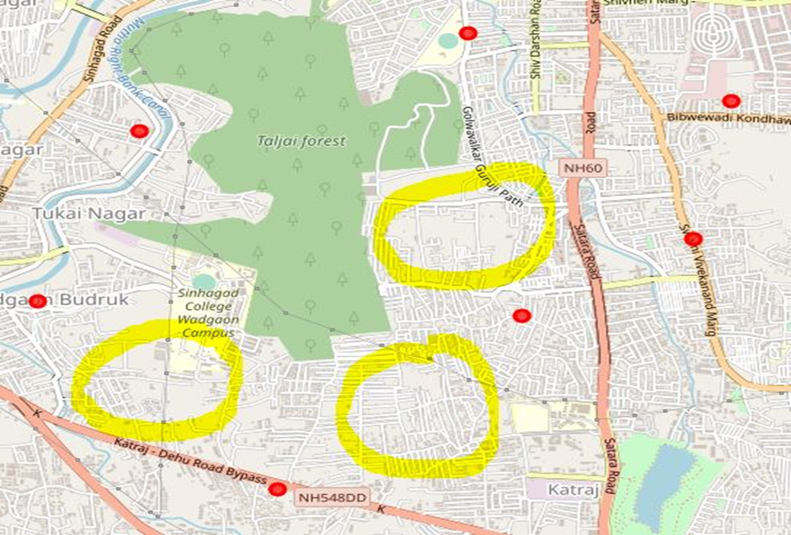
Conclusion
The Cluster label 0 neighbourhoods have the least amount of Multiplex venues around them.
The Cluster label 2 neighbourhoods have the most multiplex venues
Depending upon the location and proximity to nearby neighbourhoods, the following 3 spots can be considered for construction of a new Multiplex –

Slide 12
References
Phdessay, “Multiplex Industry in India,” [Online]. Available: https://phdessay.com/multiplex-industry-in-india/
Business World, “The Lord of the Screens,” [Online]. Available: http://www.businessworld.in/article/The-Lord-Of-The-Screens/09-10-2018-161838/
Wikipedia, “Pune,” [Online]. Available: https://en.wikipedia.org/wiki/Pune

